Slide 1

Tablet Classification App
ATU Galway - B.Eng(Hons) Software and Electronic Engineering
Project Engineering
Josh Thompson
G00422756
People with memory difficulties struggle to identify their medication and remember if they have taken it. This app solves that issue using machine learning.

Slide 2
Research & Requirements
Success criteria
The machine learning model I have trained correctly classifies all 4 tablet classes.
The backend returns correct prediction via API.
Frontend receives tablet prediction from the backend, retrieves user schedule, and correctly displays whether the tablet is required at the current time of day.
User’s intake log is stored in the database.
Existing products
Product | What it does | What’s missing
Hero Smart Dispenser | Tablet schedule and reminders | No image classification
Pharmasee | AI pill recognition | No schedule or logging
Smart Pill ID | Photo identification | No schedule or logging
Gap identified: No product combines real-time mobile image-based tablet classification with a personalised schedule check and intake logging for users.

Slide 3
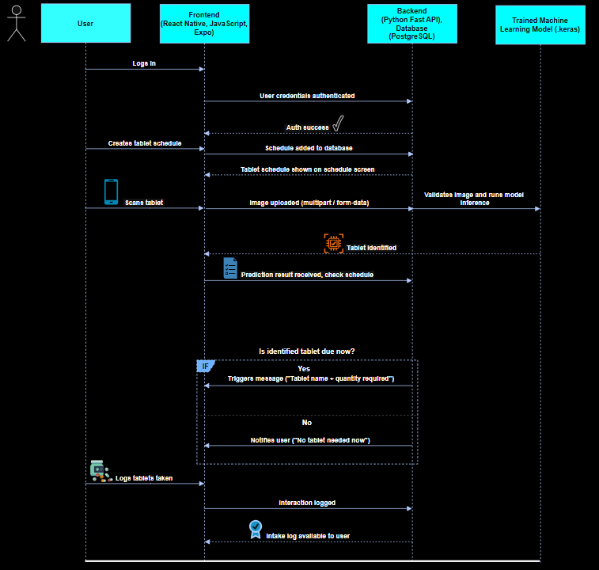
System Architecture
Backend and database are containerised using Docker Compose. Frontend is a React Native mobile app communicating with the backend over HTTP using JSON and multipart form data for image uploads

Slide 4
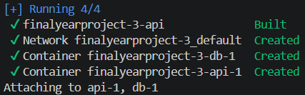
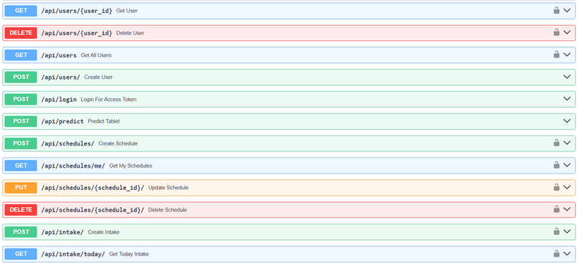

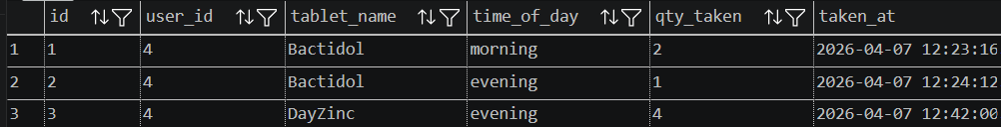
Implementation - Python FastAPI & PostgreSQL Database
Frameworks
Authentication:
FastAPI + Uvicorn, PostgreSQL database, containerised with Docker Compose (Two services: FastAPI app container and PostgreSQL container, with healthcheck-based depends_on to ensure correct startup ordering).
JWTs implemented via python-jose, bcrypt password hashing via passlib. Bcrypt 72-byte truncation issue identified and resolved
Database:
PostgreSQL via SQLAlchemy ORM - 3 tables:
Users
Tablet_schedules
Intake_logs
These tables are linked via foreign keys, so one user is only attributed to their own tablet schedule and can only view their own intake logs.
Endpoints:
POST /api/users - Registration
POST /api/login - JWT issuance
POST/GET/PUT/DELETE /api/tablet-schedules - Schedule management
POST/GET /api/log-intake - intake-logging
POST /api/predict - Image classification endpoint
Users table
Tablet Schedule table
Intake Logs table

Slide 5
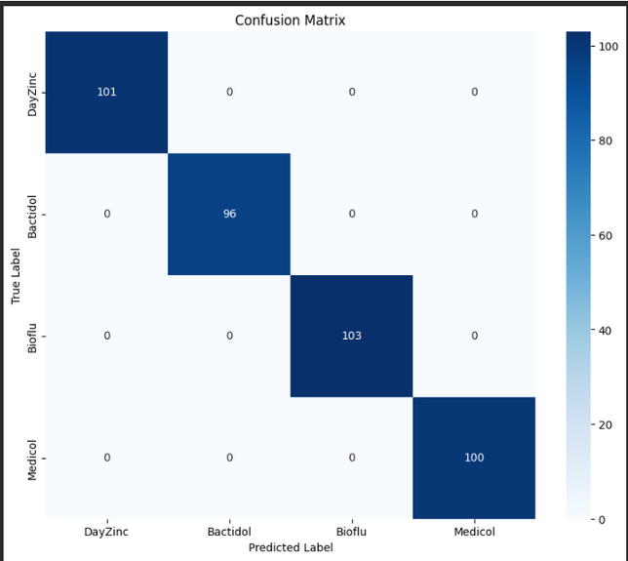
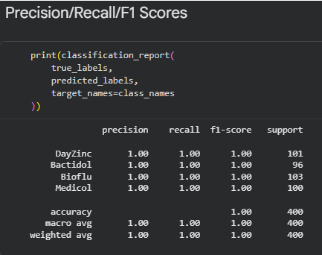
Implementation - Machine Learning
Stage | Train Acc | Val Acc
Custom CNN, 10 classes, batch=32 | ~85% | ~42%
Custom CNN, 4 classes, batch=32 | ~97% | ~64%
Custom CNN, 10 classes, batch=32 | ~98% | ~83%
ResNet50, AdamW, early stopping | >99% | >99%
Summary:
I took a powerful pre-built image classification engine and removed its original output layer and attached my own 4-class tablet classifier on top. From my research, this is the standard transfer learning pattern for image classification.
Architecture:
ResNet50 pretrained on ImageNet (include_top=False), GlobalAveragePooling2D, Dense(4, softmax)
Dataset:
Kaggle Pharmaceutical Drugs and Vitamins Synthetic images - 4,000 images across 4 classes.
Final Confusion Matrix & Precision/Recall/F1-Scores
Hyperparameter tuning
Epochs - Experimented with various numbers of epochs during training over the weeks from 2,10,15,25,30,1000.
Batch size - Reduced my batch size from 32 to 16 produced a 19% jump in validation accuracy as it allowed for better model generalization by introducing noise.
Optimiser - Switched from Adam to AdamW. I researched these optimisers and found that using AdamW results in better generalisation and reduced overfitting.
Data split - 80/10/10, 70/15/15, 65/25/10
Class reduction - Highest performing classes based on f1-scores were chosen for the final model.

Slide 6
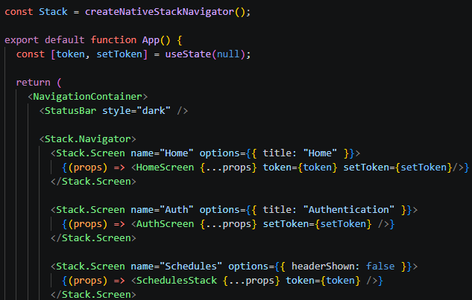
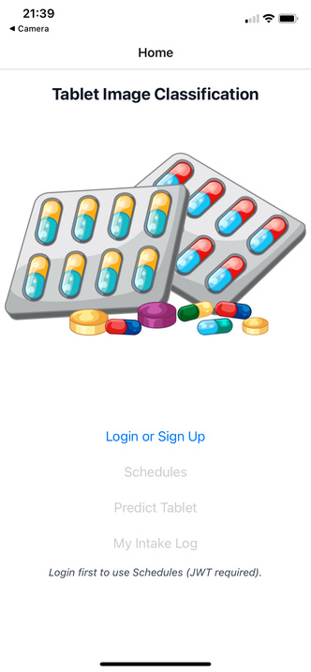
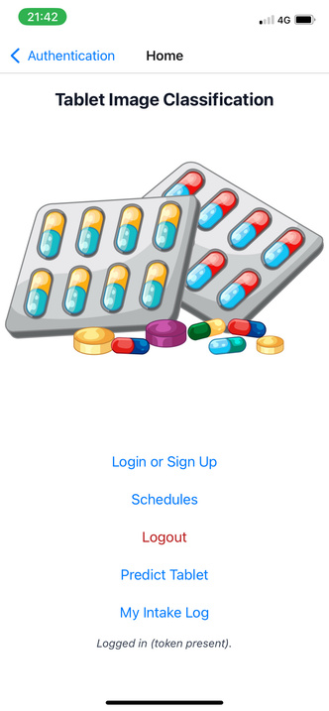
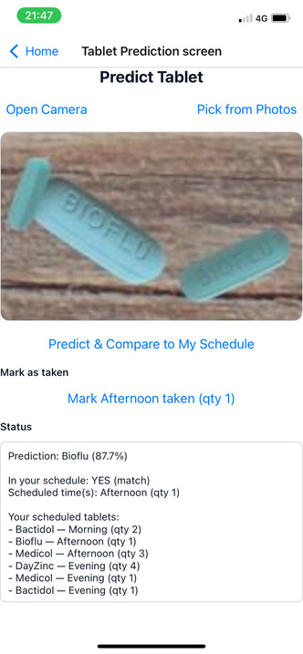
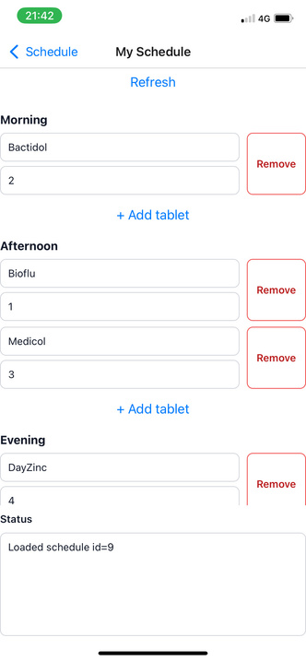
Implementation - Frontend
Frameworks:
JWT token is stored in React state at app level in App.js. The token is passed as prop, which allows login to update the global auth state
Schedules has its own nested stack navigator from Schedule Home screen to View Schedule or Create Schedule
React Native + Expo, JavaScript.
Navigation:
Single stack navigator managing all screens - Home, Authentication, Schedules (contains its own nested stack navigator for Schedule Home, View Schedule and Create Schedule), Prediction and Intake Log.
Navigation between screens is handled through text link buttons on home Screen
Home Screen (Before Login)
Home Screen (After Login)
Prediction Screen
View/Edit Schedule Screen
Screens:
Home - JWT protected routes greyed out before login/registration, accessible after.
Authentication - Registration and login with email/password.
Create Schedule - Tablet name, dosage, time of day.
View Schedule - grouped by Morning, Afternoon, Evening.
Tablet Prediction - Expo-image-picker, camera or photo library, predict and compare to schedule.
Intake Log - Mark as taken button, today’s history.

Slide 7
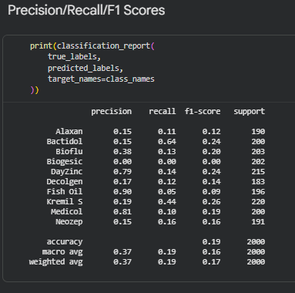
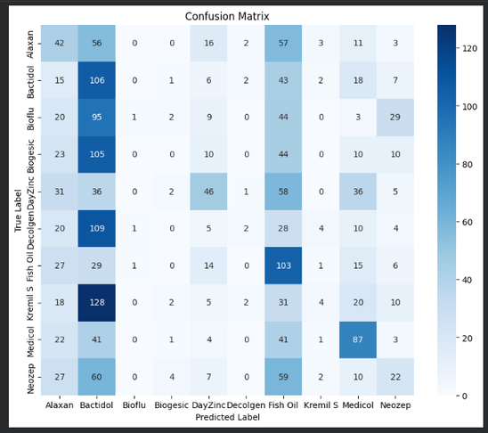


Testing - ML Model
Precision/Recall/F1 progression
Before & After Confusion Matrices:
F1-score risen from 0.19 (early run, 10 classes) to 1.00 for all classes (final ResNet50 run)
Check for data leakage
SHA256 hash check confirmed zero duplicate images between train/val/test sets
The image on the left is from when I was training the model using all 10 classes with my own custom-built CNN, image on the left is the ResNet50 model, trained on 4 classes. The model I built from scratch performed poorly, confusing many different tablet classes with each other before. I analysed the f1-scores, precision, and recall of the model on the left to find the best performing classes. I used this information to choose which classes I would keep training the model on, and to drop the poor performing classes.
Tablet class ‘Kremil S’ was originally one of the four chosen classes, however after further testing I had to remove this, as it was being predicted too much due to how visually similar it appears to the other pills.
Real-world testing limitation
Some misclassification was found during on internet-sourced images (DayZinc predicted as Bioflu, Bioflu as Bactidol). The model has learned to recognise synthetic tablets very well, but real-world photos of the same classes look different enough to sometimes confuse the model. To fix this, I plan to retrain the model on a larger, real-world photographic dataset.

Slide 8
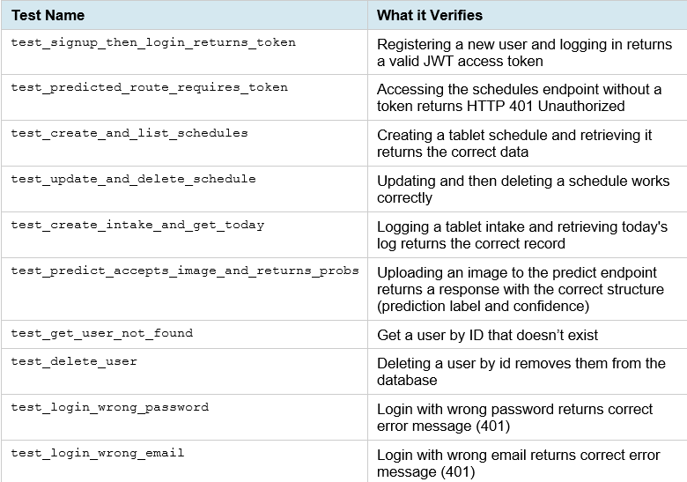

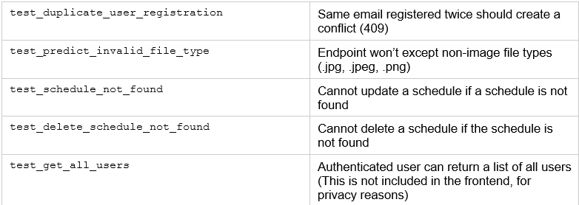
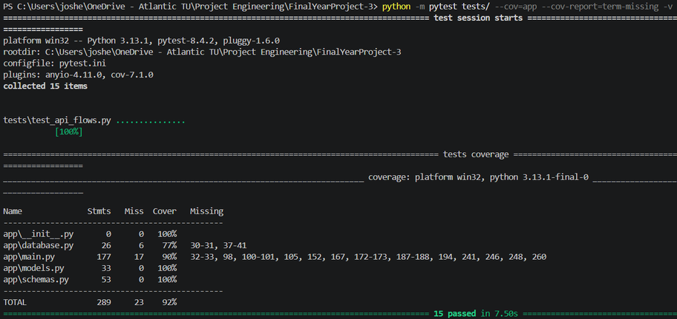
Testing - API (Pytest)
Setup & Configuration
Unittest.mock.patch is applied at module level to patch the model loading with a dummy model before app.main is imported. This avoids slow TensorFlow load and removes ML file dependency from the tests.
API Endpoint tests
DummyModel.predict() always returns fixed, fake probabilities, isolating API logic from ML accuracy.
Problem: Using sqlite:///:memory:, as a new empty database is created for every connection. So, when the test fixture creates the tables on one connection, and then FastAPI opens a second connection to handle the request, the second connection sees a completely empty database with no tables.
Solution: Use a file-based SQLite database instead, so all connections share the same data.
Pytest coverage:
I have 15 tests for the API endpoints with an overall coverage of 92%, missing 6 tests in database.py (90% coverage) and 17 tests in main.py (77% coverage)

Slide 9
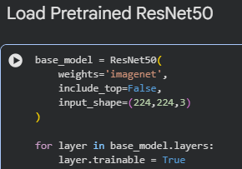
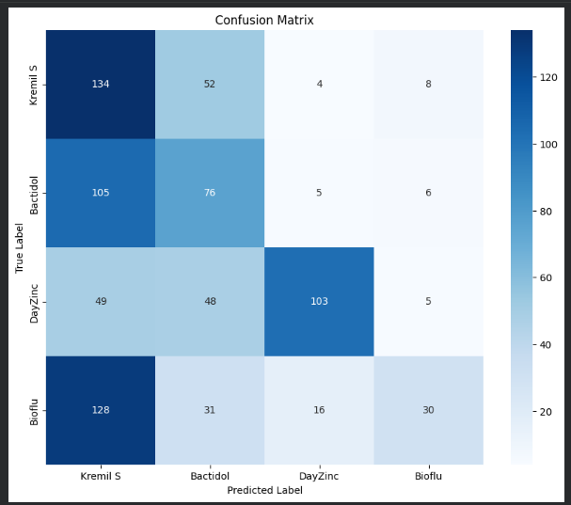

Problem Solving
Layer freezing error
Batch size discovery
Class reduction
All ResNet50 layers were set to trainable=False initially, preventing learning. I identified this problem while discussing my ML model with Michelle and telling her about the issues I was having during training.
The fix to this issue was to set all layers trainable=True.
I adopted a trial-and-error approach when training my machine learning model to try to really understand what can affect the results and how. I found that by reducing the batch size from 32 to 16 produced a 19% jump in validation accuracy, which was one of the biggest improvements in my ML development.
Using a 10-class model persistently confused visually similar tablets. I used per-class F1 scores and visual inspections of all 10 classes to select the four most distinct. ‘Kremil S’ was explicitly excluded due to chronic overprediction
Hardware to software project
Christmas demo flaw
A problem identified during the Christmas demonstration was the password login credentials contradicts the memory-impaired user. I have acknowledged this, and have proposed biometric face ID as a future development of my project
During the ideation stage of the project, I was mainly focused on doing a hardware project. After meetings with my supervisor discussing these ideas, I was made aware of some timing risks with my ideas, so I decided to complete a software project as a result.

Slide 10
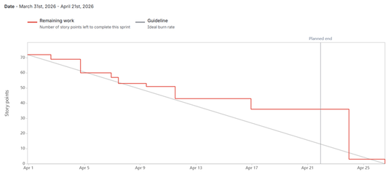
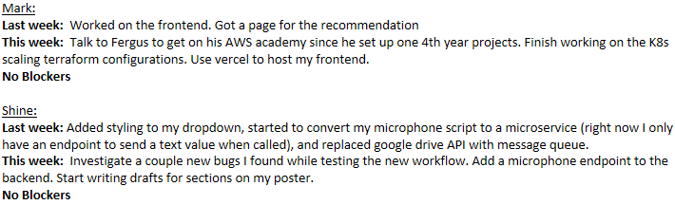
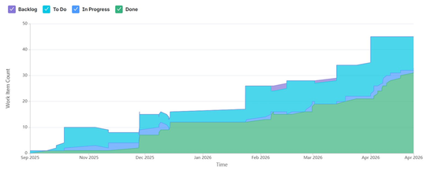
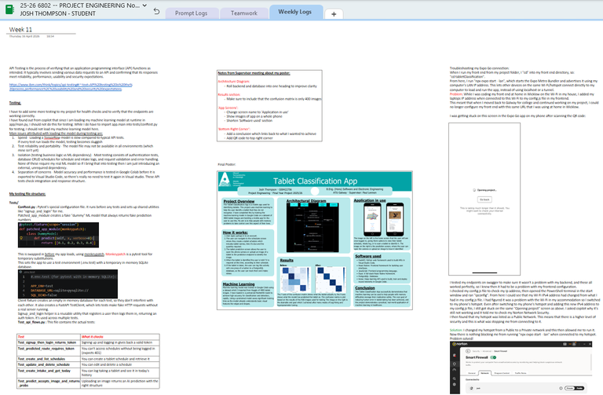
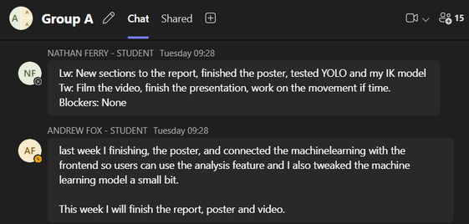
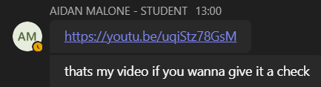

Project Management
Jira - Sprint Management Link to Jira Board
Sprints tracked throughout - epics created for frontend, backend, research, ML model training and more.
Scrum & Project Tutorial Standups
Weekly standups in Ben’s tutorial class, documenting progress made, work to be completed, and blockers, for everyone in my class doing software projects every week.
OneNote - Weekly Logs
All weekly progress I made has been documented, including research and findings, code snippets, problems encountered.
Teamwork & Collaboration
Weekly meeting with project supervisor to update on project progression, review work completed.
Teams groupchat with class for updating each other on progress made each week for people who couldn’t make it to the standup meetings.
Calls with peers to review each other’s work

Slide 11
Future work
Biometric login -
Face ID/fingerprint through expo-local-authentication. This is the most important accessibility fix.
Push notifications -
Reminds user when tablet is due, as currently the app helps a user to identify a tablet once they have already remembered to take one.
Expanded dataset -
I want to retrain the model on real-world photos to close the domain gap with synthetic training images. I would also like to scale back up to the original 10-class identifier to verify if it maintains it’s accuracy on a larger dataset.
Caregiver access -
I think a second account role for remote monitoring of a patient’s intake log would be extremely beneficial for intake tracking.

Slide 12
Thanks for listening!

